Slide 1
Design Issues of Network layer

Slide 2
Network Layer
The network layer or layer 3 of the OSI (Open Systems Interconnection) model is concerned with the delivery of data packets from the source to the destination across multiple hops or links.
Features :
Main responsibility of Network layer is to carry the data packets from the source to the destination.
If the packets are too large for delivery, they are fragmented i.e., broken down into smaller packets.
It decides the route to be taken by the packets to travel from the source to the destination among the multiple routes available in a network (also called as routing).
The source and destination addresses are added to the data packets inside the network layer.

Slide 3
Services of Network Layer
Packetizing
The process of encapsulating the data received from upper layers of the network(also called as payload) in a network layer packet at the source and decapsulating the payload from the network layer packet at the destination is known as packetizing.
The source host adds a header that contains the source and destination address and some other relevant information required by the network layer protocol to the payload received from the upper layer protocol, and delivers the packet to the data link layer.
The destination host receives the network layer packet from its data link layer, decapsulates the packet, and delivers the payload to the corresponding upper layer protocol.
The routers in the path are not allowed to change either the source or the destination address.

Slide 4
Forwarding & Routing
Every router has a forwarding table. A router forwards a packet by examining a packet's header field and then using the header field value to index into the forwarding table.
The value stored in the forwarding table corresponding to the header field value indicates the router's outgoing interface link to which the packet is to be forwarded.

Slide 5
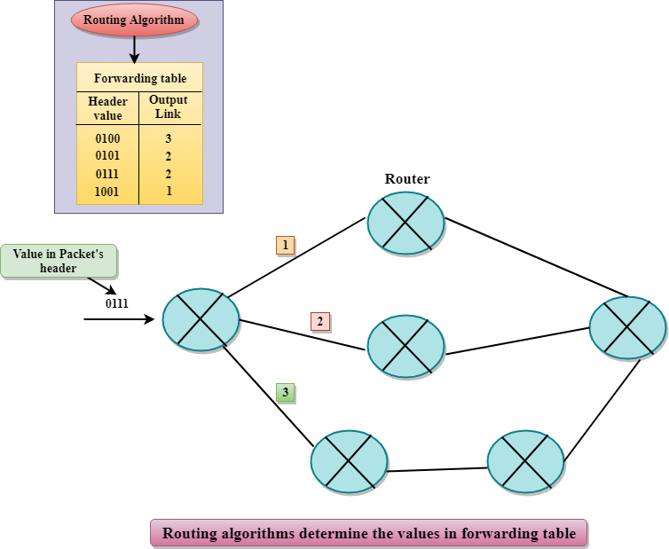

Slide 6
For example, the router with a header field value of 0111 arrives at a router, and then router indexes this header value into the forwarding table that determines the output link interface is 2.
The router forwards the packet to the interface 2.
The routing algorithm determines the values that are inserted in the forwarding table.

Slide 7
Logical Addressing: The data link layer implements the physical addressing and network layer implements the logical addressing.
Logical addressing is also used to distinguish between source and destination system.
The network layer adds a header to the packet which includes the logical addresses of both the sender and the receiver.

Slide 8
The designers who are concerned with designing this layer needs to cater to certain issues.
The design issues can be elaborated under four heads −
Store − and − Forward Packet Switching
Services to Transport Layer
Providing Connection Oriented Service
Providing Connectionless Service

Slide 9
Store − and − Forward Packet Switching
The node which has a packet to send, delivers it to the nearest router.
The packet is stored in the router until it has fully arrived and its checksum is verified for error detection. Once, this is done, the packet is forwarded to the next router.
Since, each router needs to store the entire packet before it can forward it to the next hop, the mechanism is called store − and − forward switching.

Slide 10
Services to Transport Layer
The network layer provides service to its immediate upper layer, namely transport layer, through the network − transport layer interface. The two types of services provided are −
Connection Oriented Service − In this service, a path is setup between the source and the destination, and all the data packets belonging to a message are routed along this path.
Connectionless Service − In this service, each packet of the message is considered as an independent entity and is individually routed from the source to the destination.

Slide 11
Providing Connection Oriented Service
In connection − oriented services, a path or route called a virtual circuit is setup between the source and the destination nodes before the transmission starts.
All the packets in the message are sent along this route.
When all the packets are transmitted, the virtual circuit is terminated and the connection is released.

Slide 12
Providing Connectionless Service
In connectionless service, since each packet is transmitted independently, each packet contains its routing information and is termed as datagram.
The network using datagrams for transmission is called datagram networks.
No prior setup of routes are needed before transmitting a message.
Each datagram belong to the message follows its own individual route from the source to the destination.

Slide 13
In short
Routing:
Issue: Determining the best path for data packets to travel from the source to the destination.
Addressing:
Issue: Assigning unique addresses to devices on the network for proper identification.
Packet Switching:
Issue: Deciding how data is broken into packets and how these packets are routed through the network.

Slide 14
Error Handling:
Issue: Dealing with errors that may occur during packet transmission.
Congestion Control:
Issue: Managing network traffic to prevent congestion and ensure smooth data flow.
Interoperability:
Issue: Ensuring that devices from different manufacturers can communicate with each other seamlessly.
Security:
Issue: Protecting data from unauthorized access and ensuring the integrity of the communication.

